Slide 1
CAR 163916753 Finding

Slide 2
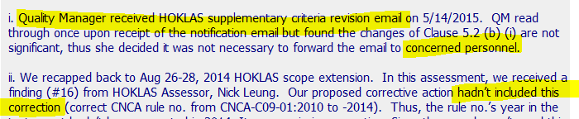
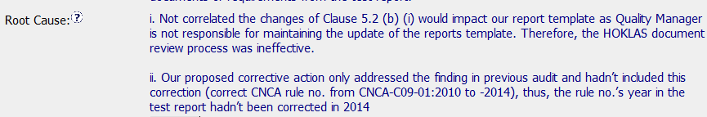
163916753
Explain how/If the nonconformity is fully addressed in the analysis – Jenni
WHY does the QM receive the HOKLAS revision emails instead of the person responsible for the report templates?
How are revisions made to templates between 2-year reviews?
The review back to the previous template revision doesn’t explain why the correction didn’t happen at that time and brings up more questions.
No analysis of any other programs or templates that might have this same issue.
Explain how/If the analysis supports the root cause statement – Mark
Why?
- Why didn’t the QM think the changes would impact report template? Why is the QM receiving the updates if not responsible for report templates?
- How are program changes addressed in between document review cycles, regardless of test report usage?

Slide 3

163916753
Explain how/If the analysis supports the Scope of Nonconformance statement - Kathy
The analysis does seem to support the scope of nonconformance since it discussed
HOKLAS solely: however, it did not explain why it was limited to HOKLAS only. I would like
to ask the CAR owner if there are any other schemes or accreditations for which the
QM receives updates.

Slide 4
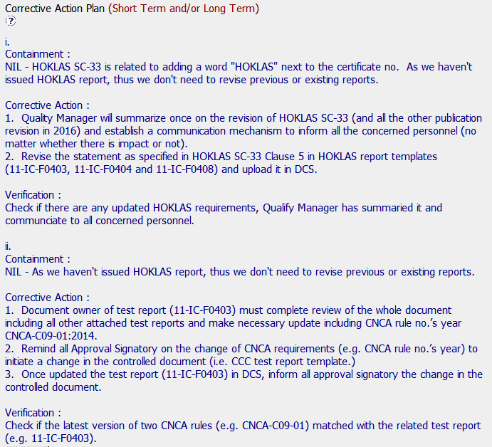
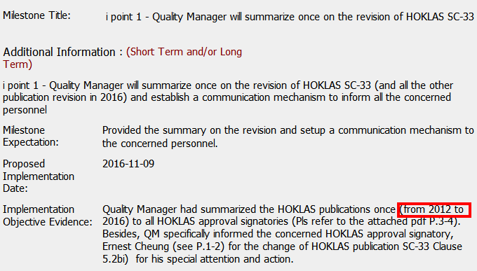
163916753
Explain why/If the Corrective Action Plan will prevent the recurrence of the nonconformity – Gunsimar
Disclaimer: In the absence of a thorough understanding of the HOKLAS Lab Accreditation requirements, one may not be in the best position to assess whether the Corrective Actions truly address the identified issue. However an attempt will still be made.
Corrective Action partially address the NCR:
1. The corrective action does not address the need to create a SOP (mirroring the HOKLAS Lab Accreditation scheme) requiring a process with designated responsibility for ensuring that any publications and or updates as received are actioned within a set time frame, who is responsible, list of documents that will be impacted, and if so who are the owners of those impacted documents, the communication format, audience etc.
2. There were publications from as far back as 2012 and notifying staff of these changes 4 years hence may be pointless or create confusion.

Slide 5

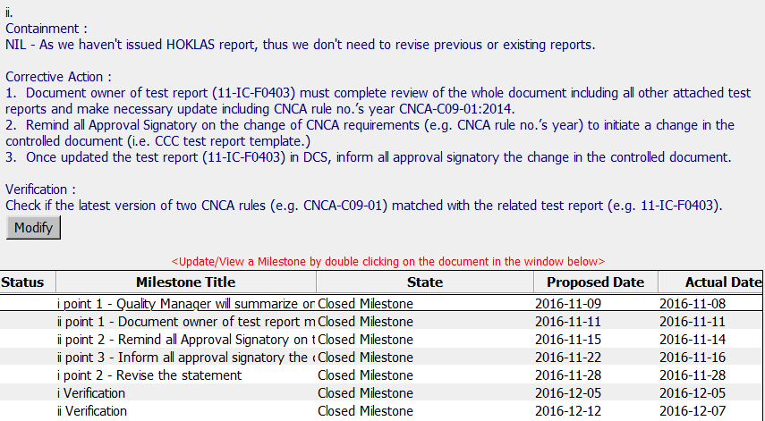
163916753
Explain how/If the containment milestone “stopped the bleeding” – Jenni
- Explains why no correction is required
Containment should state why no immediate action is required (low volume, template revised in 3 weeks, etc.)
Confirm that/If all corrective action milestones are aligned to each item of the corrective action plan – Mark
Explain how/If the verification milestone confirmed the effective implementation of the corrective action plan – Kathy
Yes, there were 2 verification milestones. They showed that 1) the QM did forward on
The email of changes to HOKLAS requirements to staff who reviewed them. 2) Those
Changes resulted in a revision of the templates.

Slide 6
Study for Finding CAR 163916753 – AP Team A
 | Team Review Criteria - Findings | Related to | Presented by
1 | ·Explain how/If the nonconformity is fully addressed in the analysis | Analysis | JY
2 | ·Explain how/If the analysis supports the root cause statement
3 | ·Explain how/If the analysis supports the Scope of Nonconformance statement
4 | ·Explain why/If the Corrective Action Plan will prevent the recurrence of the nonconformity | Corrective Action | Catherine
5 | ·Explain how/If the containment milestone “stopped the bleeding”
6 | ·Confirm that/If all corrective action milestones are aligned to each item of the corrective action plan
7 | ·Explain how/If the verification milestone confirmed the effective implementation of the corrective action plan | Verification | Larisa

Slide 7
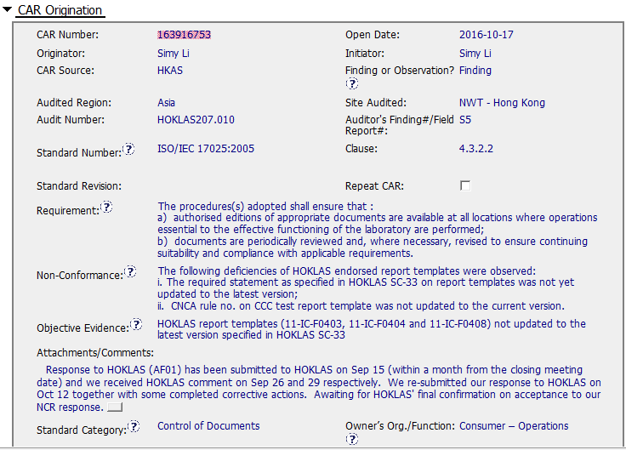
CAR# 163916753

Slide 8
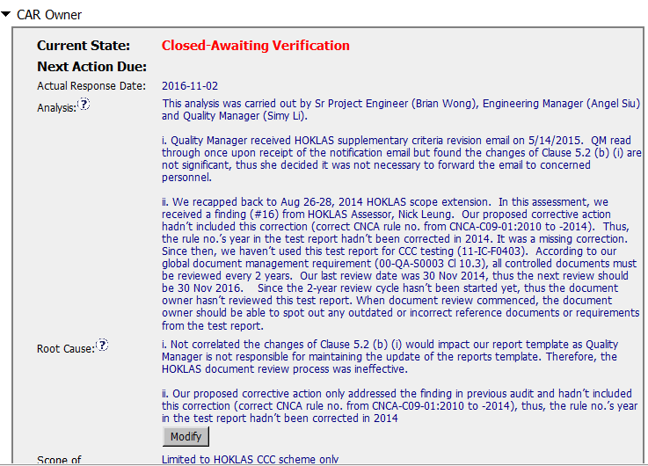
CAR# 163916753
Partially – For item 2 – Analysis only included what happened but no real why and root cause analysis conducted.
For item 1 – Seems not a root cause statement. May need more precise and concise wording
For item 2 – Seems only address what happened. Not a root cause.
By JY
 | Team Review Criteria - Findings
1 | ·Explain how/If the nonconformity is fully addressed in the analysis
2 | ·Explain how/If the analysis supports the root cause statement
3 | ·Explain how/If the analysis supports the Scope of Nonconformance statement
Notes:
Highlight key points for below criteria:
•Explain how/If the nonconformity is fully addressed in the analysis
•Explain how/If the analysis supports the root cause statement
•Explain how/If the analysis supports the Scope of Nonconformance statement

Slide 9
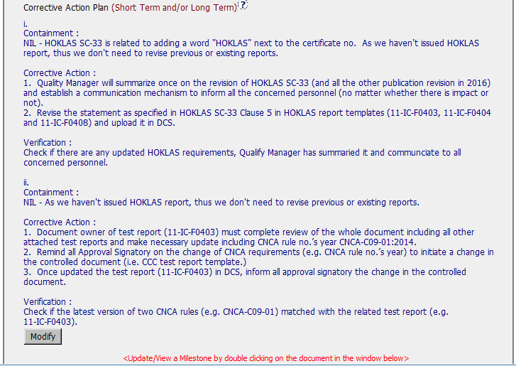
CAR# 163916753
By Catherine
4 | ·Explain why/If the Corrective Action Plan will prevent the recurrence of the nonconformity
5 | ·Explain how/If the containment milestone “stopped the bleeding”
6 | ·Confirm that/If all corrective action milestones are aligned to each item of the corrective action plan
Notes:
Highlight key points for below criteria:
•Explain why/If the Corrective Action Plan will prevent the recurrence of the nonconformity
•Explain how/If the containment milestone “stopped the bleeding”
•Confirm that/If all corrective action milestones are aligned to each item of the corrective action plan

Slide 10
CAR# 163916753
4. Explain why/If the Corrective Action Plan will prevent the recurrence of the nonconformity
For item i),
the communication mechanism was established and no matter whether there is impact or not, and the report template has been updated in DCS.
the Corrective Action can fully prevent the recurrence of the nonconformity.
For item ii),
Mentioned the related document is revised and involved people is informed, the Corrective Action can fully prevent the recurrence of the nonconformity.

Slide 11
CAR# 163916753
5. Explain how/If the containment milestone “stopped the bleeding”
The containment milestone is marked as Nil, it’s good that the reason is described, because no any issued HOKLAS reports.

Slide 12
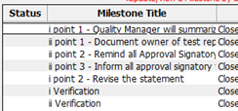
CAR# 163916753
6. Confirm that/If all corrective action milestones are aligned to each item of the corrective action plan
All corrective action milestones are aligned to each item of the corrective action plan. Very clear.

Slide 13
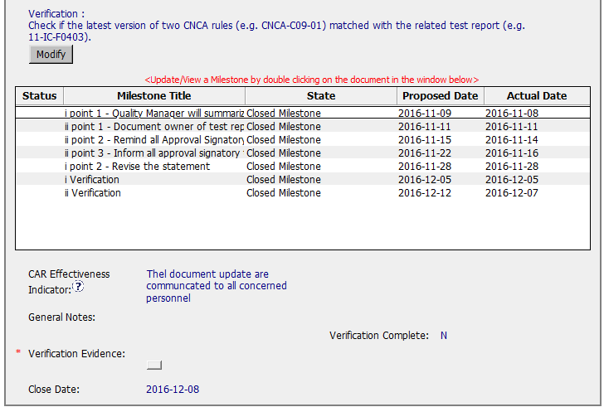
CAR# 163916753
By Larisa
7 | ·Explain how/If the verification milestone confirmed the effective implementation of the corrective action plan
Notes:
Highlight key points for below criteria:
•Explain how/If the verification milestone confirmed the effective implementation of the corrective action plan

Slide 14
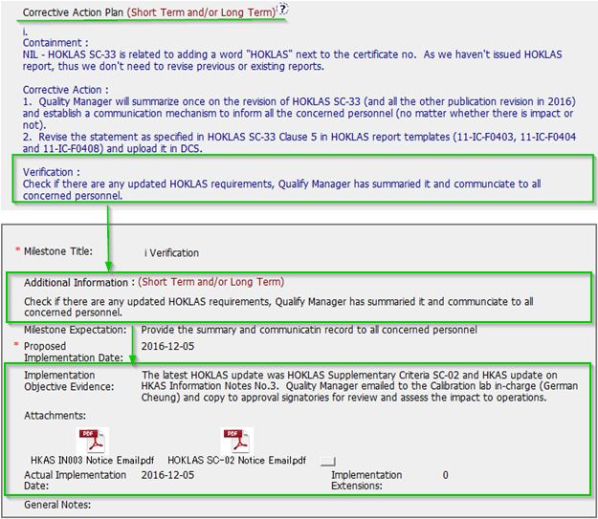
CAR# 163916753
Nonconformance i: Objective evidence attached to milestone confirms effective implementation of the corrective action plan
Notes:
Highlight key points for below criteria:
•Explain how/If the verification milestone confirmed the effective implementation of the corrective action plan

Slide 15
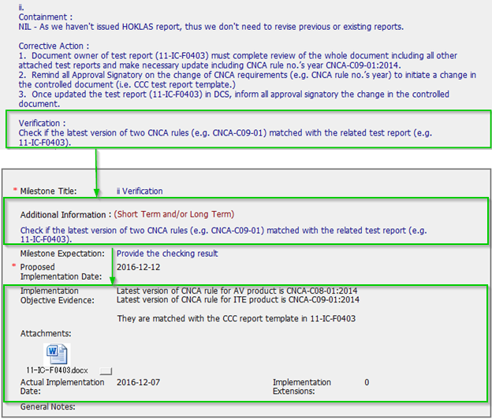
CAR# 163916753
Nonconformance ii: Objective evidence attached to milestone confirms effective implementation of the corrective action plan
Notes:
Highlight key points for below criteria:
•Explain how/If the verification milestone confirmed the effective implementation of the corrective action plan

Slide 16
CAR# 163916753 – CAR Review Criteria Check
CAR Review Criteria | Fully | Partially | Not at all | N/A
•Is the nonconformity fully addressed in the analysis? |  | √
•Does the analysis support the root cause statement? |  | √
•Does the analysis support the Scope of Nonconformance statement | √
•Will the Corrective Action Plan prevent recurrence of the nonconformity? | √
•Did the containment milestone “stop the bleeding”? | √
•Are corrective action milestones aligned to each item of the corrective action plan? | √
•Did the verification milestone confirm the effective implementation of the corrective action plan? | √

